Slide 1
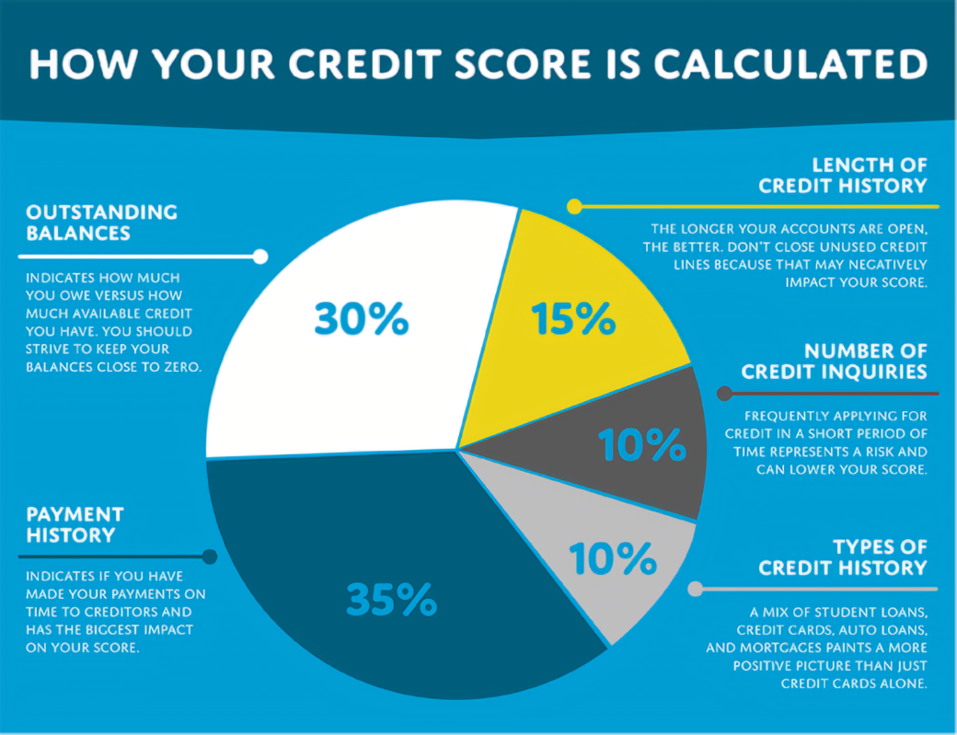
How to achieve a Healthy Credit Score
Notes:
“The instructor will ask participants if they know their current credit score?”
“The instructor will ask participants if they know how much outstanding debt that they are carrying from month to month.”
“The instructor will ask participants if they know how many on-time payments have they made on outstanding balances?”

Slide 2
Healthy credit scores
Notes:
The instructor will ask participants if they know their FICO credit score.
“Many people aren’t aware or in touch with what their credit score is and how it effects their ability to live life without worries.” “As you work hard in the workplace, think of ways to increase your credit score.” “Did you know that some employers check your credit score to see if you would be a good candidate to employ?”
Here are some strategies to increase your credit score as you extend your labor in the workplace:
Outstanding Balances
Balance Transfer
The first option you should consider to start paying down debt is a balance transfer.
A balance transfer can buy you some time to repay your debt as quickly as possible without racking up a ton of interest. The drawback to a balance transfer is that you may not qualify if your credit rating has taken a beating, and you may not be able to transfer your full outstanding balance.
Debt Consolidation Loan
With lending interest rates near record lows, why not take advantage with a debt consolidation loan? Your credit card interest rate may currently be 18.5%, but you can get a line of credit for a lot less. Homeowners can take advantage of the equity they’ve built up in their home with a HELOC (home equity line of credit). Today you can get a HELOC for as little as Prime + 0.5%.
Credit Counselling
For those in dire straits, credit counselling from a certified nonprofit agency can help you get your finances back on track. A credit counsellor will sit down with you and help develop a realistic budget, so you can put as much of your take-home pay towards credit card repayment.
These three effective ways to help tackle credit card debt are a small part of the overall process to become debt-free. To be successful, it all comes down to willpower. You have to be willing to make tough changes to your spending habits if you hope to have your credit card debt paid off some time this decade.

Slide 3
Healthy credit scores
Notes:
The instructor will ask participants if they are current on items that have payment plans. “This is a personal questions that needs immediate attention.” “Ask yourself, am I concerned that I am behind on certain payments?”
Here are a few strategies that will assist you in bringing your payment history current:
Call every creditor to make sure that you are current on payments and how you can get ahead.
Set up a schedule/budget to include all creditors that you have set up a payment plan.
Lock down a specific date to pay and stick with it. Don’t make excuses.
Establish an on-time history to make sure your creditors know that you are serious.

Slide 4
Healthy credit scores
Notes:
The instructor will ask participants how long have they had good credit or bad credit? “It is a sure thing that credit is necessary, but closing unused credit lines will negatively impact your credit score?
Here are a few strategies to prevent your credit score from being negatively impacted:
Establish a consistent payment history so that it is known that you are serious about paying off debt and increasing your credit score.
Stability is key, pay consistently, to establish a credit history.

Slide 5
Healthy credit scores
Notes:
The instructor will ask participants how many credit cards do they currently have in their possession? “As each participant considers the answer to that question, be honest, do you have ten or more credit cards in your wallet? “Did you know that the more you apply for credit cards you will be deemed as a risk”? “It doesn’t matter how many credit card offers they send you, don’t fall into that trap of applying.”
Here are a few strategies that will help you resist those numerous offers from credit card companies:
Resist those offers of credit card with a lower rate than the name brand companies.
Make sure that you do your research to accept the credit card offer that is right for the size of your family. All offers don’t fit your family size or family needs.
Select the credit card that you will consistently pay on each month, and not the minimum balance, make sure you pay the maximum that you can afford.

Slide 6
Healthy credit scores
Notes:
The instructor will ask the participants if they know what types of credit that they have and how each type affects their credit history. “Did you know that having a mix of student loans, credit cards, auto loans, and mortgage loan paints a more positive picture than just credit cards along?”
Here are a few strategies that will keep your credit in a balanced way:
1)Make sure that you have a healthy balance of student loans, credit cards , auto loans, and mortgage loans that are within your budget.
2) Make sure that you don’t overload your plate by trying to quickly raise your credit score with unnecessary credit lines to companies that aren’t legitimate on the surface.
3) Make it your goal to balance your debt.

