Slide 1
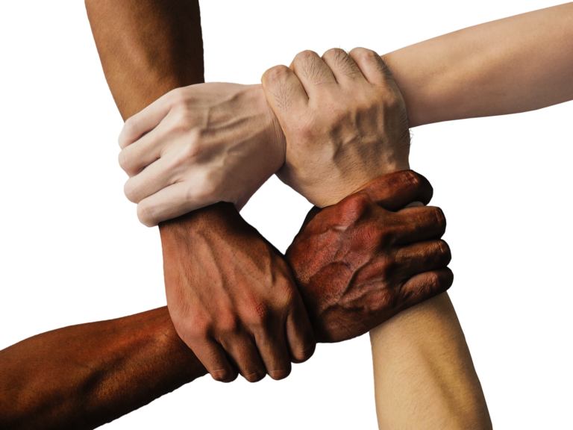
What is CULTURAL COMPETENCE?
Notes:
“The instructor will ask participants how much knowledge do they have about other cultures?”
“The instructor will ask participants if what they know about other cultures is fair and safe?”

Slide 2
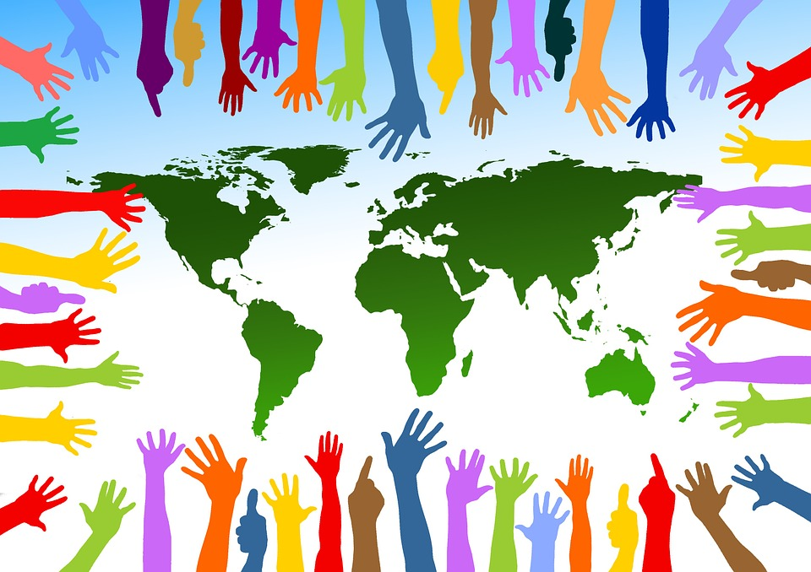
CULTURE
Notes:
The instructor will ask how many of you have traveled to foreign nations?
“As you may know, that all of us have the same struggles, but our cultures are totally different.” A simple definition of culture is “the customs, arts, social institutions, and achievements of a particular nation, people, or other social group.” “Although our world is diverse, we have to interact in such a way that respects the dignity of humanity that makes us all the same.”
Here are a few strategies that will help you understand different cultures:
Communicate. Research and learn the different ways a culture communicates. It may be as simple as how to shake hands, which hand to shake or which language is acceptable to speak or translate to a language that is acceptable.
Understand. Understanding isn’t the same as agreement, it is perceiving the significance of that culture. Try to understand the culture, not judge the culture, it has its positives and negatives just as this culture does.
Learn. Investigate the norms of different cultures to communicate equality. Each culture has its place and importance.
Trust. Learn to dismiss all suspicions and doubt by engaging into conversations that will enrich your understandings of different cultures. Ask questions that will solidify your commitment to embrace different cultures.
Unite. Invite a person from a different culture out to lunch at work. Sit down and have a meal that will enhance the workplace by encouraging a meeting of the minds. All cultures have the same thing in common. All nations or people groups want respect.
Respect. Express deep appreciation for a different cultures arts, political system, family structure. Every culture has something within it that is worthy of high esteem.
Empower. Equip yourself and others to give credence to foreign cultures. Research and embrace the depths of different cultures to find the tiny jewels within.

Slide 3
VALUES
Notes:
The instructor will ask participants to think about what they value most?
“As you ponder to answer that question, is the most valuable thing upon Earth actually people?”
“Within cultural competence, the value of each human being is beyond the price of gold. “
Here are a few strategies that will help you value different cultures and find their value and worth:
Diversity. How is your understanding of diversity? How much research have you done to increase your awareness of different cultures? Diversity has its benefits in the workplace due to the fact that different minds coming together to solve a problem is far better than one mind working alone.
Teamwork. With a greater understanding of different cultures, comes a stronger team. Unity complements any company. Teamwork under girds any effort to reach cultural competence.
Examine your values to make corrections if necessary. As you survey your own values, do you include people from different cultures readily and easily? Take a honest look at the make up of your team. How have you shown appreciation for different cultures within your sphere of influence in the workplace?
Renew your efforts to celebrate different cultures by enlisting their ideas to work on a project at work that defines their brilliance.
“Remember whatever you value, you will uplift.” Show you value different cultures by listening, embracing, and uplifting those cultures that you know little about.

Slide 4
BIASES
Notes:
The instructor will ask participants if the scales of justice always fair.
“Many participants will answer abruptly by saying, No!” As we examine our biases, make sure we are not accidentally or purposely hindering fairness in the workplace.
Here are some strategies to make sure fairness is practiced in the workplace:
Promote equality. Make sure different cultures are always heard for their ideas and input. Don’t dismiss someone because they are from a different culture.
Communicate fairness. Make sure different cultures have the same opportunities to express their opinions in the workplace as others.
Identify stereotyping and stop the effects of this practice by having workshops centered around cultural competence. Explain what is fair and how to implement fairness for all employees involved.
“Remember that we are all different, but we are all the same in so many ways.” “Bias is not effective in the workplace because it cuts production and hinders moral.”

Slide 5
Summary
As you prepare to give feedback on this module, remember to :
Communicate, Understand, Learn, Trust, Unite, Respect, Empower
“Remember that we are only as strong together, but we are weaker divided.”
Notes:
The instructor will lead a review of what learners have practiced with the slide above

